Slide 1
E&M Analysis
09/09/2025
Descriptive Analysis

Slide 2
Agenda
1 | Welcome
2 | TBD
3 | TBD
4 | TBD
5 | TBD
6 | Closing

Slide 3
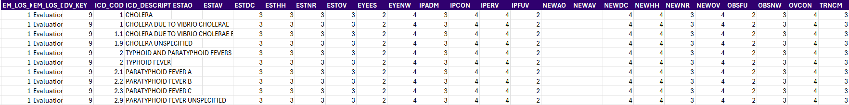
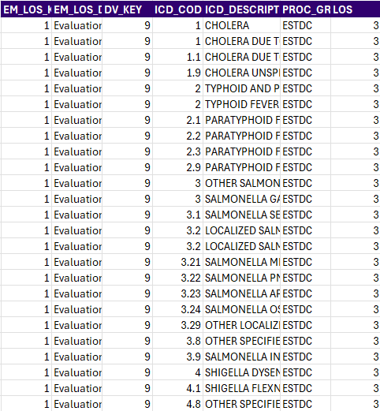
Data Transformation (Wide → Long)
.
.
.
.
.
.
.
.
.
.
.
.
.
.
.
.
.
.
.
.
.
.
.
.
.
.
.
.
.
.
.
.
.
.
.
.
.
.
.
.
.
.
.
.
.
.
.
.
.
.
.
.
.
.
.
.
.
.
.
.
Wide data: 27 columns x 184K rows
Long data: 7 columns x 4.1M rows
Data transformation standardizes raw inputs into an analysis-ready format, ensuring accurate KPIs, apples-to-apples comparisons, and scalable reporting.
.
.
.
.
.
.
.
.
.
.
.
.
.
.
.
.
.
.

Slide 4
Data Preprocessing
Standardization & Cleaning Data:
Text cleanup: removed odd spaces (NBSP), trimmed, upper-cased codes/groups; de-duplicated exact row duplicates.
ICD normalization: built a robust ICD “root” = text left of the decimal for initial analysis (e.g., 003.21, 3.02.3.2 → root 3; J45.9, J45.2 → root J45)
Consistent types: coerced LOS to numeric; preserved nulls for coverage analysis.
Trustworthy baseline: clean, consistent inputs → defensible E&M benchmarks.

Slide 5
LOS 3
LOS 2
LOS 4
LOS 5
LOS 1

Slide 8
ICD | ICD_Description | ESTAO | ESTAV | ESTDC | ESTHH | ESTNR | ESTOV | EYEES | EYENW | IPADM | IPCON | IPERV | IPFUV | NEWAO | NEWAV | NEWDC | NEWHH | NEWNR | NEWOV | OBSFU | OBSNW | OVCON | TRNCM | Grand Total
A81 | Creutzfeldt-Jakob disease, unspecified | 5 | 5 | 5 | 5 | 5 | 5 | 4 | 4 | 3 | 5 | 5 | 3 | 5 | 5 | 5 | 5 | 3 | 5 | 3 | 3 | 5 | 3 | 4.36
A19 | Acute miliary tuberculosis of a single specified site | 5 | 5 | 5 | 5 | 5 | 5 | 4 | 4 | 3 | 5 | 5 | 3 | 5 | 5 | 5 | 5 | 3 | 5 | 3 | 3 | 5 | 3 | 4.36
46 | Slow low virus infections & Orior diseases of central nervous system |  |  | 5 | 5 | 5 | 5 | 4 | 4 | 3 | 5 | 5 | 3 |  |  | 5 | 5 | 3 | 5 | 3 | 3 | 5 | 3 | 4.22
18 | Acute miliary Tuberculosis |  |  | 5 | 5 | 5 | 5 | 4 | 4 | 3 | 5 | 5 | 3 |  |  | 5 | 5 | 3 | 5 | 3 | 3 | 5 | 3 | 4.22
C81 | Nodular lymphocyte predominant Hodgkin lymphoma, unspecified site | 4 | 4 | 4 | 4 | 4 | 4 | 4 | 4 | 3 | 5 | 5 | 3 | 5 | 5 | 5 | 5 | 3 | 5 | 3 | 3 | 5 | 3 | 4.09
C85 | Unspecified B-cell lymphoma, unspecified site | 4 | 4 | 4 | 4 | 4 | 4 | 4 | 4 | 3 | 5 | 5 | 3 | 5 | 5 | 5 | 5 | 3 | 5 | 3 | 3 | 5 | 3 | 4.09
C82 | Follicular lymphoma grade I, unspecified site | 4 | 4 | 4 | 4 | 4 | 4 | 4 | 4 | 3 | 5 | 5 | 3 | 5 | 5 | 5 | 5 | 3 | 5 | 3 | 3 | 5 | 3 | 4.09
C4A | Merkel cell carcinoma of lip | 4 | 4 | 4 | 4 | 4 | 4 | 4 | 4 | 3 | 5 | 5 | 3 | 5 | 5 | 5 | 5 | 3 | 5 | 3 | 3 | 5 | 3 | 4.09
C7A | Malignant carcinoid tumor of unspecified site | 4 | 4 | 4 | 4 | 4 | 4 | 4 | 4 | 3 | 5 | 5 | 3 | 5 | 5 | 5 | 5 | 3 | 5 | 3 | 3 | 5 | 3 | 4.09
B20 | Human immunodeficiency virus [HIV] disease | 4 | 4 | 4 | 4 | 4 | 4 | 4 | 4 | 3 | 5 | 5 | 3 | 5 | 5 | 5 | 5 | 3 | 5 | 3 | 3 | 5 | 3 | 4.09

